Slide 1
Vision Based 3-D Shape Reconstruction of Flexible Manipulators from Multiple Images
CS543 Spring 2016 Project
Guoyong Li, Zheng Li and Naveen Kumar Uppalapati

Slide 2
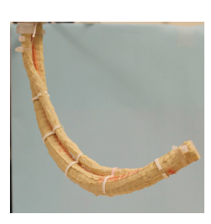
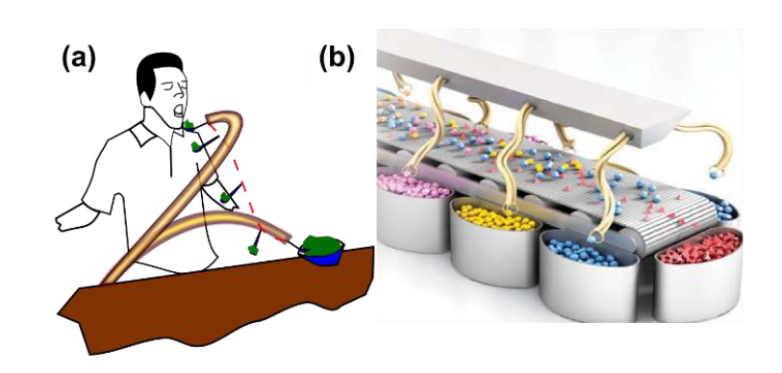
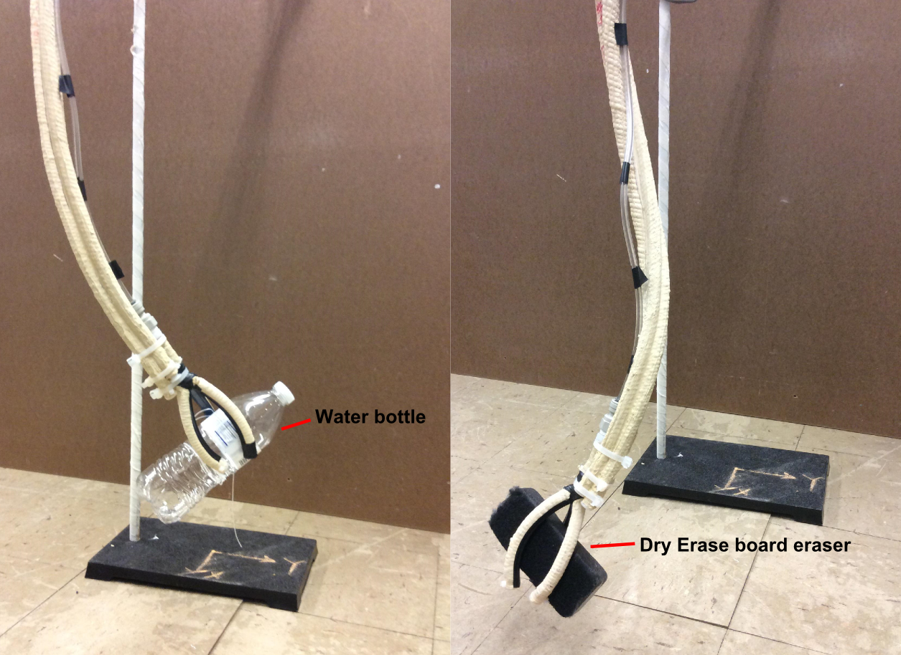
Motivation
Continuum manipulators major limitation – sensing
Few sensors developed – dependent on inaccurate models of the manipulator.
Vision based sensing to get the shape of the manipulator.
Assistive feeding and human safe automation
Notes:
Continuum flexible manipulators have major advantages that they are soft and therefore human safe. They can take complex shapes which rigid robots cannot do and hence useful in many applications like rescue operations and even in medical appplications.
Their major limitation is sensing, there is no definitive way to sense the shape this manipulators take.
Over the years there have been few sensors developed but they are largely dependent on inaccurate models of these manipulators (which are highly non linear). Therefoe vision based sensing is robust sensing method.

Slide 3
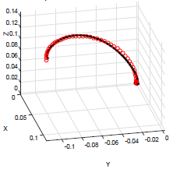

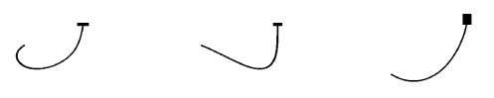
Shape Sensing Algorithm
Uses shape from silhouette technique.
Camera Calibration
Silhouette extraction
Silhouette projection and intersection
Shape estimation and curve reconstruction
Intrinsic and
extrinsic parameters
Synthetic data results

Slide 4
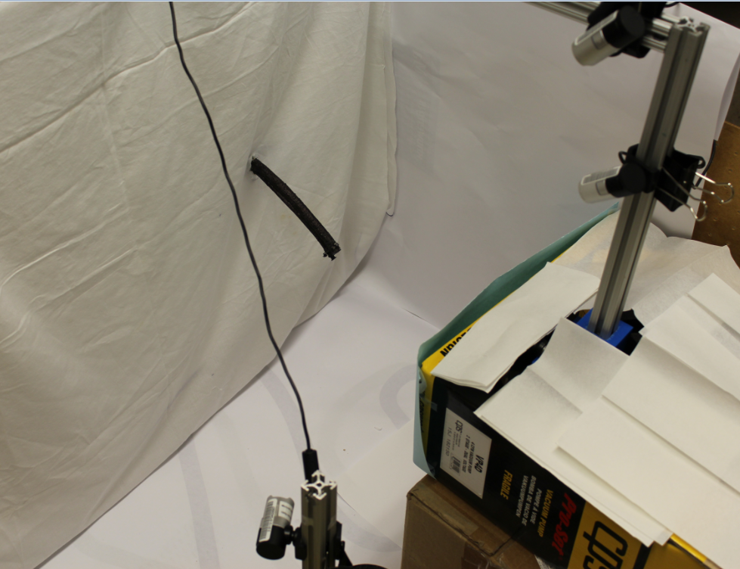
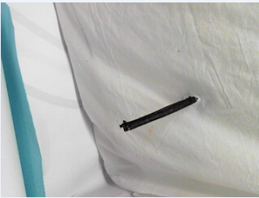
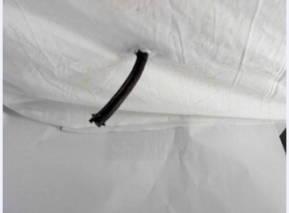
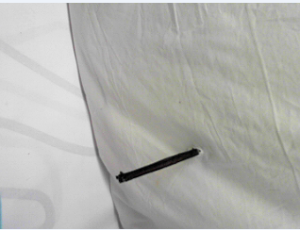
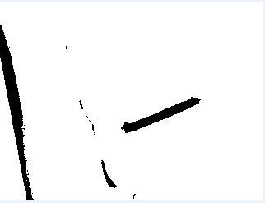
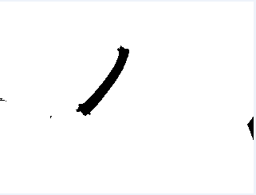
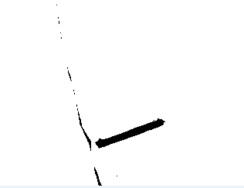
Camera Calibration and Silhouette extraction
Used Matlab Single Camera calibration toolbox.
Method to fix common world center for three cameras.
Silhouette extracted by converting to a binary image.
Resolution- 320x240
Setup
Flexible
manipulator
Microsoft lifecam studio webcam
Captured images
Extracted silhouettes

Slide 5
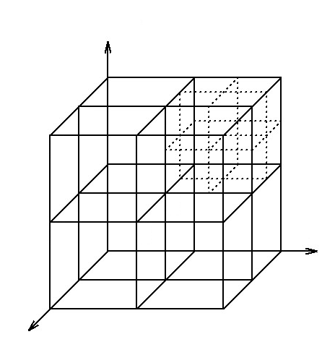
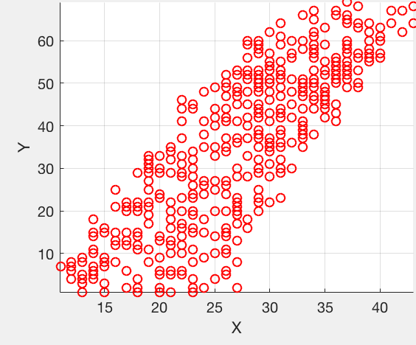
Point cloud from Silhouette intersections
Divide the space into a cube
Dimensions – 256x256x256
Check the surface layer of a big cube before calculate a small cube

Slide 6
Shape estimation and Curve reconstruction
Sphere fitting
Each point will be represented as vector using angle corresponding to a referenced vector
Re-order point cloud (based on angle)
Relationship between axis Index ~ axis Value
Fitting points as polynomial relationship between each axis
Reconstruct the spatial curve from f(Index)~Value

Slide 7
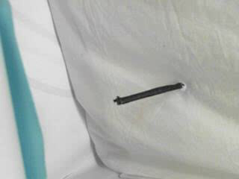
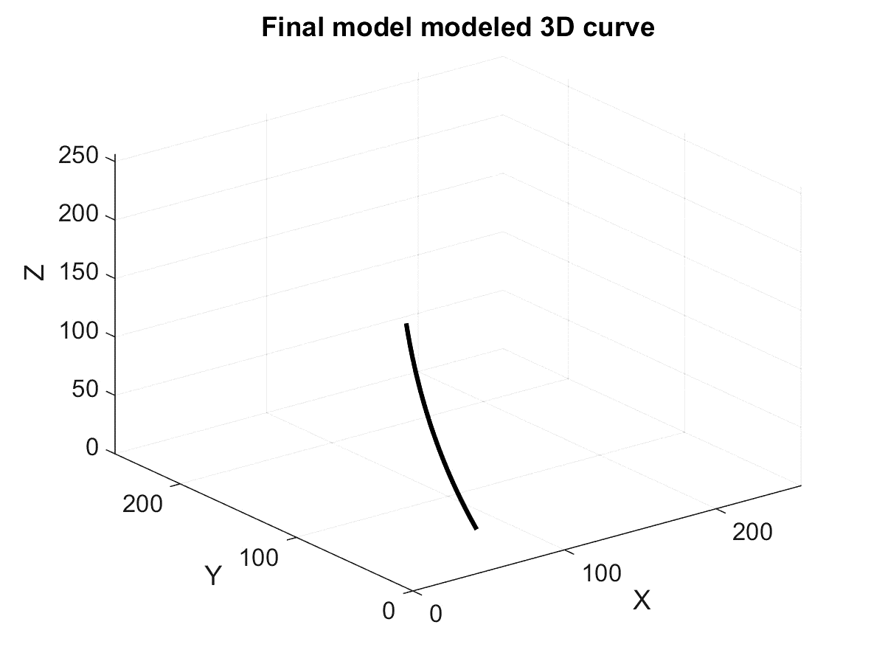
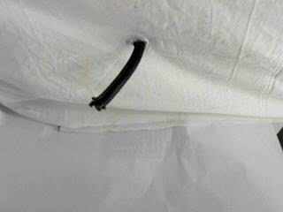
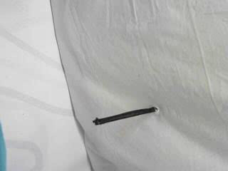
Results

Slide 8
Improvements
Capture rate: 30 frames/sec
Reconstruction time per frame : 53 seconds
160 frames ~ 142 minutes
Working on reducing this reconstruction time to try to make it real time.
Error analysis

Slide 9
References
Camarillo, David B., Kevin E. Loewke, Christopher R. Carlson, and J. Kenneth Salisbury. Vision based 3-D shape sensing of flexible manipulators. In Robotics and Automation, 2008. ICRA 2008. IEEE International Conference on, pp. 2940-2947. IEEE, 2008.
Krishnan, Girish, Joshua Bishop-Moser, Charles Kim, and Sridhar Kota. "Kinematics of a Generalized Class of Pneumatic Artificial Muscles." Journal of Mechanisms and Robotics 7, no. 4 (2015): 041014.
Trivedi, Deepak, Christopher D. Rahn, William M. Kier, and Ian D. Walker. "Soft robotics: Biological inspiration, state of the art, and future research." Applied Bionics and Biomechanics 5, no. 3 (2008):99-117.

